Slide 1
Advanced Software Engineering Course
Creational Design Patterns
Antonio Di Monaco
Computer Science Bachelor Program

Slide 2
Topics
Introduction
Creational
  Abstract Factory
  Factory Method
  Builder
  Prototype
Singleton
Reference: https://refactoring.guru/design-patterns

Slide 3
Introduction - 1
A pattern describes a problem that occurs over and over in a specific environment
A definition that we can apply almost everywhere … so in software development, so, a pattern is a reusable solution to a problem in specific context.
A pattern has:
a name: it describes our design problem, the solution and the consequences, and it’s a kind of reference
in the software development literature
a problem: when to apply a pattern, description of the context and the conditions that makes it suitable
a solution: how it works and how it fixes the problem, not in terms of a concrete design, but how you fix something
“in theory”
a consequence: which are the results and the trade-offs

Slide 4
Introduction - 2
What’s not a pattern?
Specific implementations, for example, linked lists or n-ary trees.
Of course you have implementations in specific languages, but that’s the “realization” of a pattern: what we are going to learn here is the idea behind it.
Classification criteria
Which problem does it address?
When is it applicable?
How does it perform in comparison with similar patterns?
Notes:
C++ or Java used as languages
Interface assumed as a required concept
Assume no bad references/pointers, no weird coding

Slide 5
Creational Patterns
What they do
They abstract the creation process
They define what gets created, who creates it, how it gets created, and when.
Encapsulate knowledge about which concrete classes the system uses
Hide implementation details of how instances are created and combined
Notes:
Polymorphic creation

Slide 6
Abstract Factory - Problem
Many applications must create more than one kind of object, and those objects are not independent: they form a family in which members are designed to work together.
A GUI application creates buttons, text fields, dialogs - all belonging to the same platform toolkit (Windows widgets must be mixed with Windows dialogs, never with macOS ones).
A data layer creates connections, statements, result sets - all belonging to the same database vendor.
A rendering engine creates 2D or 3D shapes of several kinds.
If the client code contains new WindowsButton(), new MacOsDialog() and so on, three problems appear at once:
Coupling — the client is hard-wired to concrete classes, changing the platform means touching every creation site.
Combinatorial explosion — with n product roles and m families, naive code can assemble inconsistent combinations (a Windows button inside a macOS dialog). There are mⁿ possible mixes but only m valid ones.
Scattering of knowledge — the rule "which concrete classes go together" is repeated in every place where objects are created, instead of living in one single place.
The client should be able to say "give me a coherent family of products" without knowing or naming any concrete class, and without being able to build an inconsistent mix.

Slide 7
Abstract Factory - Usage
When to use it:
your system must work with families of related objects (2+ product roles that must be used together)
you want to keep the concrete classes out of the client code (platform/infrastructure independence)
the set of families is expected to grow, and you want growth to be additive
mixing products from different families would be *illegal* or at least undesirable.
When not to use it:
there is only one product role → Factory Method (or even a simple factory) is enough; Abstract Factory would be over-engineering
the products of different families are freely mixable (no consistency constraint) → independent factories or plain interfaces suffice
the family has many product roles and you only ever use a few → consider whether a lighter abstraction captures the real need.

Slide 8
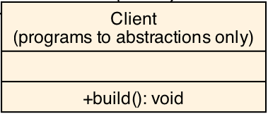
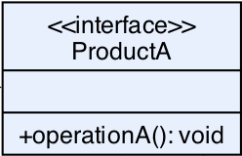
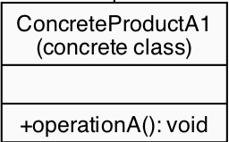
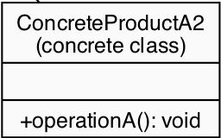
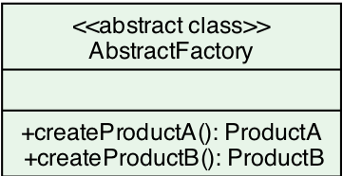
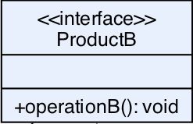
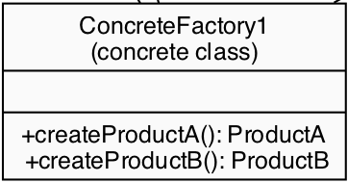
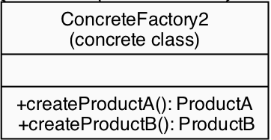
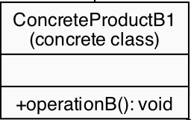
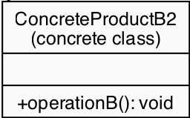
Abstract Factory – Class Diagram
products
implements
uses
creators
implements
implements

Slide 9
UI Widgets – Abstract Factory – Products (1)
public interface Button {
void render();
void onClick(Runnable action);
}
public class WindowsButton implements Button {
@Override
public void render() {
//
}
@Override
public void onClick(Runnable action) {
//
}
}
public class MacButton implements Button {
@Override
public void render() {
//
}
@Override
public void onClick(Runnable action) {
//
}
}

Slide 10
UI Widgets – Abstract Factory – Products (2)
public interface Checkbox {
void render();
boolean isChecked();
void toggle();
}
public class WindowsCheckbox implements Checkbox {
private boolean checked = false;
@Override
public void render() {
//
}
@Override
public boolean isChecked() {
return checked;
}
@Override
public void toggle() {
checked = !checked;
//
}
}
public class MacCheckbox implements Checkbox {
private State state = State.NotChecked;
@Override
public void render() {
//
}
@Override
public boolean isChecked() {
return state == State.Checked;
}
@Override
public void toggle() {
state = getNextState(state);
}
}

Slide 11
UI Widgets – Abstract Factory - Factory
public interface GUIFactory {
Button createButton();
Checkbox createCheckbox();
}
public class WindowsFactory implements GUIFactory {
@Override
public Button createButton() {
return new WindowsButton();
}
@Override
public Checkbox createCheckbox() {
return new WindowsCheckbox();
}
}
public class MacFactory implements GUIFactory {
@Override
public Button createButton() {
return new MacButton();
}
@Override
public Checkbox createCheckbox() {
return new MacCheckbox();
}
}

Slide 12
UI Widgets – Abstract Factory - Application
public class Application {
private final Button button;
private final Checkbox checkbox;
public Application(GUIFactory factory) {
this.button = factory.createButton();
this.checkbox = factory.createCheckbox();
}
public void renderUI() {
button.render();
checkbox.render();
}
public void simulateInteraction() {
button.onClick(() -> {});
checkbox.toggle();
checkbox.render();
}
...
...
public static void main(String[] args) {
String osName = System.getProperty("os.name").toLowerCase();
GUIFactory factory;
if (osName.contains("mac")) {
factory = new MacFactory();
} else {
factory = new WindowsFactory();
}
Application app = new Application(factory);
app.renderUI();
app.simulateInteraction();
}
}

Slide 13
Abstract Factory – Database example

Slide 14
Abstract Factory – Pros and cons
Advantages:
Isolation of concrete classes: creation knowledge is centralized in one class per family; the client is decoupled from implementation details.
Consistency by construction: incompatible combinations cannot be expressed.
Ease of swapping families: one reference change (or one config line) re-themes the whole system, possibly at runtime.
Open/Closed: new families are added without touching existing code.
Disadvantages:
More classes: with m families and n product roles you create roughly m·n + m + n + 1 types. For small systems this is heavy.
Harder to extend the product dimension: adding a new product role (a new method on AbstractFactory) forces changes to the abstract factory and to every concrete factory, even those that cannot produce the new product. The pattern is open along the family axis but closed along the product-role axis.
Indirection cost: one extra layer of abstraction to understand, debug and test; the "why" must be obvious or the code becomes a maze of interfaces.

Slide 15
Factory Method – Problem
A well-designed system should not be littered with new ConcreteClass(...) calls scattered through business logic.
Hard-wiring concrete classes at creation points causes three classic problems:
Tight coupling to implementations: client code that says new WindowsButton() knows and depends on a concrete class. Swapping the implementation means editing every call site.
Violation of the Open/Closed Principle (OCP): adding a new variant (a new OS, a new logging backend, a new payment provider) forces modification of existing, tested code instead of simple addition.
Violation of the Dependency Inversion Principle (DIP): high-level modules end up depending on low-level concrete classes rather than on abstractions.
The Factory Method solves all three by moving the new expression into a dedicated, overridable method — the Factory Method — and making all client code depend only on the abstract product type.

Slide 16
Factory Method - Usage
When to use it:
A class can't anticipate the class of objects it must create (e.g., a framework that doesn't know which plugins users will register).
A class wants its subclasses to specify the objects it creates (polymorphic creation — this is the defining case).
The system must provide a family of related products without committing to concrete classes (this shades into Abstract Factory; Factory Method handles one product dimension at a time).
You want to build a small library/framework whose extended value lies in customizing it with user-defined products.
Rule of thumb: if you find yourself writing switch/if chains or multiple new calls on concrete classes that vary by environment, platform, or configuration — extract a Factory Method.
Key Differences from Factory Method
Factory Method: Creates one type of object
Abstract Factory: Creates families of related objects
Factory Method: Uses inheritance
Abstract Factory: Uses composition

Slide 17
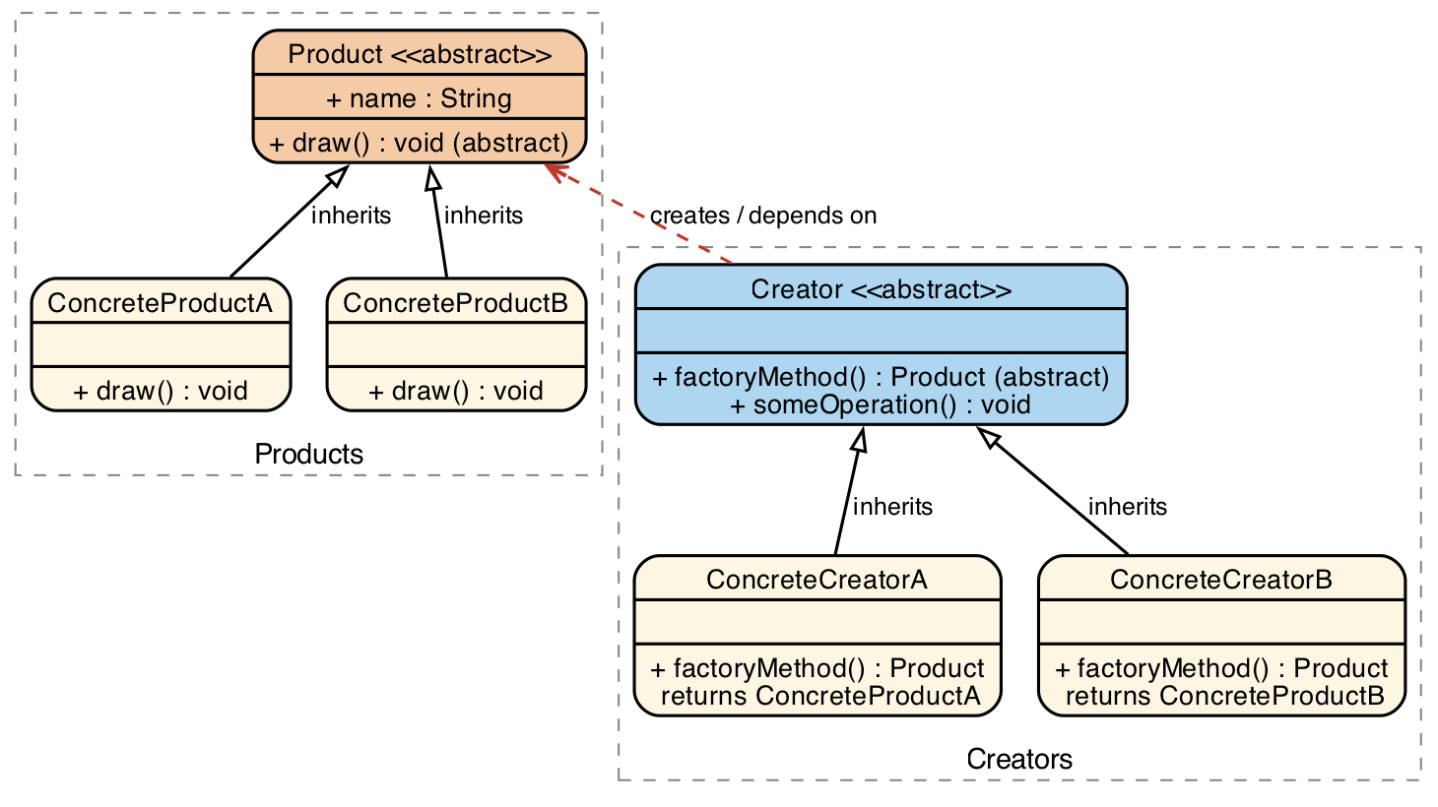
Factory Method – Class diagram

Slide 18
Logistics – Factory Method - Products
public class Ship implements Transport {
public void deliver(String cargo, String destination) {
//
}
public double estimateCost(double distanceKm) { return // }
public int capacityTons() { return // }
}
public interface Transport {
void deliver(String cargo, String destination);
double estimateCost(double distanceKm);
int capacityTons();
}
public class Drone implements Transport {
public void deliver(String cargo, String destination) {
//
}
public double estimateCost(double distanceKm) { return // }
public int capacityTons() { return //; }
}
public class Truck implements Transport {
public void deliver(String cargo, String destination) {
//
}
public double estimateCost(double distanceKm) { return // }
public int capacityTons() { return // }
}

Slide 19
Logistics – Factory Method – Factory & Application
public abstract class Logistics {
/** Factory Method — subclasses decide which Transport to instantiate. */
protected abstract Transport createTransport();
/** Business logic that relies on the product via its interface. */
public void planDelivery(String cargo, String destination, double distanceKm) {
Transport transport = createTransport(); // ← factory method call
… transport.capacityTons()
… transport.estimateCost(distanceKm)
transport.deliver(cargo, destination);
}
}
public class RoadLogistics extends Logistics {
protected Transport createTransport() { return new Truck(); }
}
public class SeaLogistics extends Logistics {
protected Transport createTransport() { return new Ship(); }
}
public class AirLogistics extends Logistics {
protected Transport createTransport() { return new Drone(); }
}
public class LogisticsDemo {
public static void main(String[] args) {
Logistics road = new RoadLogistics();
Logistics sea = new SeaLogistics();
Logistics air = new AirLogistics();
road.planDelivery("Electronics", "Berlin", 600);
sea.planDelivery("Crude Oil", "Rotterdam", 8500);
air.planDelivery("Medical Supplies", "Munich Hospital", 120);
}
}

Slide 20
Factory Method – Logger example

Slide 21
Factory Method – Pros and cons
Benefits:
Single point for knowing concrete classes: All new expressions for the product live in exactly one method per creator.
Open/Closed Principle: New products enter the system as new classes only.
Dependency Inversion: Clients, frameworks, and tests depend on abstractions; concrete implementations are injected via the chosen factory.
Testability: A test can supply a fake/stub product through a test-only creator — no production code changes.
Communication: The Factory Method is an explicit, documented seam: reading createLogger() tells you "a logger is created here, and it may vary".
Costs / trade-offs:
More classes: every product needs a matching creator. For one-off scripts this is over-engineering — the pattern pays off when variation is expected.
The Factory Method returns an abstraction, so clients cannot use product-specific features without downcasting (avoid that; extend the Product interface instead).
It creates one object of one type. If you need a coordinated family of products, reach for Abstract Factory.

Slide 22
Builder – Problem
Sometimes a class constructor is not enough or does not scale well.
Telescoping constructors are unmaintainable. A class with 8 optional parameters needs up to 2^8 constructor overloads (or one 8-argument constructor where callers pass null, null, "x", null, ...). Nobody can tell what the fourth argument is.
Named, self-documenting steps. builder.setRole("Engineer") or .header("Content-Type", "application/json") reads like a sentence; a positional argument list does not.
Immutability without sacrificing flexibility. The product can be final with only getters: the builder is mutable while building, and the finished object is immutable for its whole life. A plain constructor forces you to choose between "all-or-nothing" parameters and a mutable bean.
Stepwise construction of complex objects. Some objects need several phases (create parts → assemble → validate → compute derived state). The builder makes each phase explicit, and build() is the single place where validation and derived values are computed — the product can never exist in an invalid or half-initialized state.
Notes:
Suitable for builders like String, SQL ...

Slide 23
Builder - Usage
When to use it:
the algorithm for creating a complex object is independent of the resulting representation (or you want it to be)
the construction process can be broken into a sequence of steps that may run in a fixed order
the object has many parameters, several of them optional, and you want a readable, extensible way to specify them
you want the finished product to be immutable or to guarantee an invariant state (validation at build() time)
the construction involves collections, nested objects, or derived values that are easier to accumulate incrementally than to pass in one shot.
When not to use it:
The object has few, mostly required parameters — a constructor (or a record) is simpler and just as readable.
The "complexity" is only in the number of similar values (e.g. a list of items) — pass the collection directly.
You need to create objects very frequently in hot paths and object allocation overhead matters — a builder allocates an extra object per product.
Notes:
Suitable for builders like String, SQL ...

Slide 24
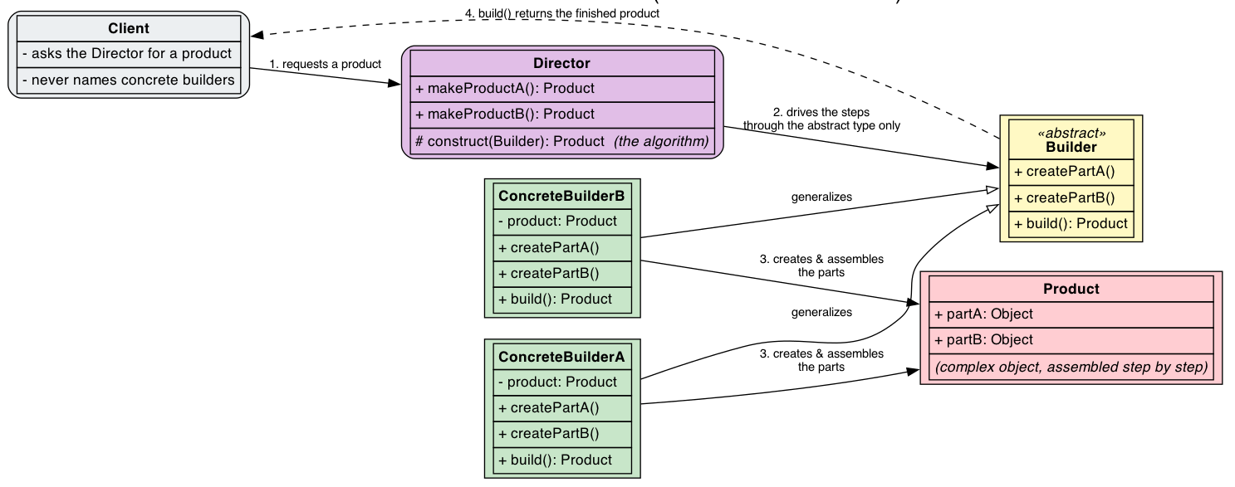
Builder – Class Diagram
Notes:
Suitable for builders like String, SQL ...

Slide 25
Car – Builder – Products & Interfaces
public class Car {
private String engine;
…
private int seats;
…
private boolean hasGPS;
private boolean hasParkingSensors;
…
// package-private setters (used only by builders)
// public getters
// toString() with formatted output
}
public interface CarBuilder {
void buildEngine();
void buildSeats();
void buildElectronics();
…
…
Car getResult();
}

Slide 26
Car – Builder – Concrete Builders
public class SportsCarBuilder implements CarBuilder {
private Car car = new Car();
public void buildEngine() { car.setEngine("4.0L V8 Twin-Turbo (620 HP)"); }
public void buildSeats() { car.setSeats(2); }
public void buildElectronics() {
car.setHasGPS(true);
car.setHasParkingSensors(true);
}
public Car getResult() {
Car result = this.car;
this.car = new Car();
return result;
}
}
public class EconomyCarBuilder implements CarBuilder {
private Car car = new Car();
public void buildEngine() { car.setEngine("1.0L 3-Cylinder Turbo (100 HP)"); }
public void buildSeats() { car.setSeats(5); }
public void buildElectronics() {
car.setHasGPS(false);
car.setHasParkingSensors(true);
}
public Car getResult() {
Car result = this.car;
this.car = new Car();
return result;
}
}

Slide 27
Car – Builder – Director & Application
public class CarDealerDirector {
private CarBuilder builder;
public CarDealerDirector(CarBuilder builder) {
this.builder = builder;
}
public void setBuilder(CarBuilder builder) {
this.builder = builder;
}
/** Fully loaded — every option included. */
public void buildFullyLoaded() {
builder.buildEngine();
builder.buildSeats();
builder.buildElectronics();
}
/** Base model — only mechanical essentials. */
public void buildBaseModel() {
builder.buildEngine();
builder.buildSeats();
}
public void buildTestDriveModel() {
builder.buildEngine();
}
}
public class CarBuilderDemo {
public static void main(String[] args) {
// 1. Director builds a fully loaded sports car
SportsCarBuilder sportsBuilder = new SportsCarBuilder();
CarDealerDirector director =
new CarDealerDirector(sportsBuilder);
director.buildFullyLoaded();
Car sportsCar = sportsBuilder.getResult();
System.out.println(sportsCar);
// 3. Base model economy car (fewer steps)
EconomyCarBuilder economyBuilder = new EconomyCarBuilder();
director.setBuilder(economyBuilder);
director.buildBaseModel();
Car economyCar = economyBuilder.getResult();
System.out.println(economyCar);
// 4. Test drive model (different recipe)
director.setBuilder(sportsBuilder);
director.buildTestDriveModel();
Car testDrive = sportsBuilder.getResult();
System.out.println(testDrive);
}
}

Slide 28
Fluent Builder
public interface CarBuilder {
CarBuilder buildEngine();
CarBuilder buildSeats();
CarBuilder buildElectronics();
…
…
Car getResult();
}
public class EconomyCarBuilder implements CarBuilder {
private Car car = new Car();
public CarBuilder buildEngine(String type) {
car.setEngine(type);
return this;
}
public CarBuilder buildSeats(int noSeats) {
car.setSeats(noSeats);
return this;
}
public CarBuilder buildElectronics(
boolean withGPS, Boolean withSensors) {
car.setHasGPS(withGPS);
car.setHasParkingSensors(withSensors);
return this;
}
public Car getCar() {
Car result = this.car;
this.car = new Car();
return result;
}
}
Car myCar = new EconomyCarBuilder()
.buildEngine("1.0L 3-Cylinder Turbo (100 HP)")
.buildSeats(5)
.buildElectronics(true, false)
.getCar();

Slide 29
Builder – Computer

Slide 30
Fluent Builder – SQL Query

Slide 31
Builder – Pros and cons
Advantages
Construction and representation are decoupled: new representations are added by adding a concrete builder, without touching the algorithm or the client (Open/Closed Principle).
Complex construction becomes readable and self-documenting.
The product can be immutable and always valid — validation is centralized in build().
Optional parameters are handled naturally: simply skip the step.
Disadvantages
More classes: every product needs at least one builder class (plus a Director in the GoF form). For simple objects this is pure overhead.
The construction logic is spread over several methods/classes, which can make it harder to follow than a single constructor.
A fluent chain that is too long becomes its own readability problem; and a builder with void setters plus a separate build() is more verbose than a plain constructor for objects with few required parameters.

Slide 32
Prototype - Problem
Constructing some objects can be expensive or redundant.
Decouple clients from concrete product classes. The client only knows the abstract Prototype type; it never names the concrete class it is creating.
Avoid a proliferation of nearly identical classes. If 50 report layouts or 30 pizza variants differ only in initialization data, you do not need 50 or 30 classes — you need a few prototypes plus customization of clones.
Add new object types at runtime (Open/Closed Principle). Registering a new prototype instance introduces a new "type" of product without writing a new class and without recompiling the client.
Avoid factory hierarchies that mirror product hierarchies. When the set of products grows, a parallel hierarchy of factories would have to grow in lockstep.

Slide 33
Prototype - Usage
When to use it:
the classes to instantiate specify a fixed but large set of types, and instantiating every variation through explicit construction is impractical
there is a hierarchy of classes that are almost identical except for how they are initialized
you need to add new objects to a system without revealing the details of their creation (privacy/encapsulation of the construction logic).
Benefits:
Performance: Avoids expensive initialization
Considerations:
Cloning complexity: Deep vs shallow cloning decisions
Circular references: Can cause issues with deep cloning
Key Method: Clone!!!

Slide 34
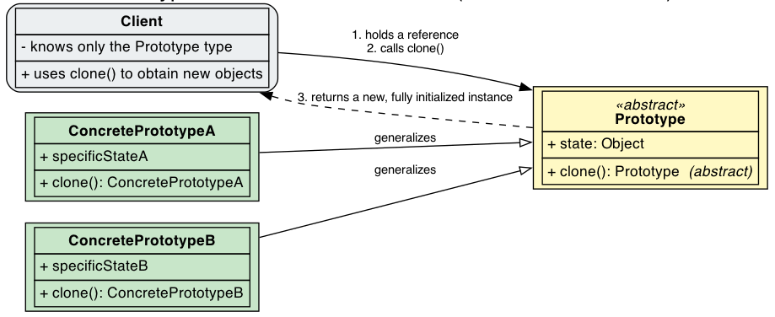
Prototype – Class diagram

Slide 35
Document Templates – Prototype – Base class and registry
public abstract class Document {
private String title;
private String author;
private String createdDate;
private List<String> sections;
private String footer;
private boolean readOnly;
protected Document(Document source) {
this.title = source.title;
this.author = source.author;
this.createdDate = source.createdDate;
this.sections =
new ArrayList<>(source.sections);
this.footer = source.footer;
this.readOnly = source.readOnly;
}
public abstract Document clone();
public abstract String render();
}
public class DocumentTemplateRegistry {
private final Map<String, Document> templates = new HashMap<>();
public void register(String name, Document prototype) {
templates.put(name, prototype.clone()); // store a safe copy
}
/** Returns a fresh clone — never the stored instance. */
public Document createFromTemplate(String name) {
Document template = templates.get(name);
if (template == null) {
throw new IllegalArgumentException(
"Template not found: " + name);
}
return template.clone();
}
}

Slide 36
Document Templates – Prototype - Products
public class Report extends Document {
private String reportType;
private String department;
private String period;
private Map<String, String> metadata; // ← deep-copied
private List<String> recipients; // ← deep-copied
private Report(Report source) {
super(source);
this.reportType = source.reportType;
this.department = source.department;
this.period = source.period;
this.metadata = new LinkedHashMap<>(source.metadata);
this.recipients = new ArrayList<>(source.recipients);
}
@Override
public Report clone() { return new Report(this); }
// getters, setters
}
public class Invoice extends Document {
private String companyName;
private String companyAddress;
private String customerName;
private String invoiceNumber;
private List<LineItem> lineItems;
private double taxRate;
private String paymentTerms;
private String currency;
private Invoice(Invoice source) {
super(source);
this.companyName = source.companyName;
this.companyAddress = source.companyAddress;
this.customerName = source.customerName;
this.taxRate = source.taxRate;
this.paymentTerms = source.paymentTerms;
this.currency = source.currency;
this.lineItems = new ArrayList<>();
for (LineItem item : source.lineItems) {
this.lineItems.add(new LineItem(item)); // ← each item cloned
}
}
@Override
public Invoice clone() { return new Invoice(this); }
public void addLineItem(String desc, int qty, double price) {
lineItems.add(new LineItem(desc, qty, price));
}
// Inner class with its own copy constructor
public static class LineItem {
private String description;
private int quantity;
private double unitPrice;
public LineItem(LineItem source) {
this.description = source.description;
this.quantity = source.quantity;
this.unitPrice = source.unitPrice;
}
}
// getters, setters
}
public class Contract extends Document {
private String contractType;
private String partyA, partyB;
private String effectiveDate, expirationDate;
private List<String> clauses; // ← deep-copied
private String governingLaw;
private boolean requiresNotarization;
private Contract(Contract source) {
super(source);
this.contractType = source.contractType;
this.partyA = source.partyA;
this.partyB = source.partyB;
this.clauses = new ArrayList<>(source.clauses); // deep copy
this.governingLaw = source.governingLaw;
this.requiresNotarization = source.requiresNotarization;
}
@Override
public Contract clone() { return new Contract(this); }
// getters, setters
}

Slide 37
Document Templates – Prototype - Application
public class DocumentPrototypeDemo {
public static void main(String[] args) {
// SETUP (once at startup)
DocumentTemplateRegistry registry =
new DocumentTemplateRegistry();
Invoice invoiceTemplate = new Invoice();
invoiceTemplate.setCompanyName("TechCorp GmbH");
invoiceTemplate.setCompanyAddress(
"Dietmar-Hopp-Allee 16, Walldorf");
invoiceTemplate.setTaxRate(0.19);
invoiceTemplate.setPaymentTerms("Net 30 days");
invoiceTemplate.setCurrency("EUR");
Contract ndaTemplate = new Contract();
ndaTemplate.setContractType(
"Non-Disclosure Agreement (NDA)");
ndaTemplate.setPartyA("TechCorp GmbH");
ndaTemplate.setGoverningLaw("German Law (BGB)");
ndaTemplate.addClause(
"Confidential Information shall include...");
ndaTemplate.addClause(
"Obligations: maintain strict secrecy...");
ndaTemplate.addClause(
"Term: 3 years from Effective Date.");
registry.register("invoice", invoiceTemplate);
registry.register("nda", ndaTemplate);
// USAGE (per transaction — cheap clone + customize)
// Invoice for Customer A
Invoice invA = (Invoice) registry.createFromTemplate(
"invoice");
invA.setInvoiceNumber("INV-2026-0042");
invA.setCustomerName("AutoTech AG");
invA.addLineItem("Cloud License", 1, 15000.00);
// Invoice for Customer B (different currency, tax)
Invoice invB = (Invoice) registry.createFromTemplate(
"invoice");
invB.setInvoiceNumber("INV-2026-0043");
invB.setCustomerName("DataFlow Inc.");
invB.setCurrency("USD");
invB.setTaxRate(0.0875);
// NDA for new partner
Contract nda = (Contract) registry.createFromTemplate("nda");
nda.setPartyB("InnoSoft Ltd.");
nda.setEffectiveDate("2026-09-01");
nda.addClause("Custom: includes source code disclosure.");
// Template unaffected by additions to clone
// ndaTemplate still has 3 clauses, nda has 4
}
}

Slide 38
Prototype - Shapes

Slide 39
Prototyping ... with Javascript ❤️
const foo = {
text: “Hey”,
callMe(name) { return `${this.text} ${name}!` }
};
const CarPrototype = {
run() { console.log(`${this.model} GO!`); }
};
function Car(model) {
this.model = model;
};
Object.assign(Car.prototype, CarPrototype);
const myCar = new Car(”Maserati”);
myCar.run(); // “Maserati GO!”
console.log(myCar.toString()); // "[object Object]"
console.log(foo.text); // “Hey”
console.log(foo.callMe(“Antonio”)); // “Hey Antonio!”
console.log(foo.toString()); // "[object Object]"
Javascript objects have a prototype.
Even a prototype, that is an object, has a prototype!
console.log(Object.getPrototypeOf(foo)); // { }
console.log(Object.getPrototypeOf(foo.__proto__)); // null
foo.__proto__ = null;
console.log(foo.text); // “Hey”
console.log(foo.callMe("Antonio")); // “Hey Antonio!”
console.log(foo.toString()); // [ERR]: foo.toString is not a function

Slide 40
Prototype – Pros and cons
Advantages:
Configuring a system with variant objects without subclassing
Adding or removing object types at runtime (registry + clone)
Clones are fully initialized → expensive initialization code is skipped
Clients depend only on the abstract type → high decoupling.
Disadvantages:
Shallow-copy pitfalls: shared mutable state between original and clone
Java's clone() is awkward: protected, returns Object, requires the Cloneable marker, throws a checked exception; every concrete class must override it correctly
Deep cloning can be costly and error-prone (object cycles, transient fields, resources such as open connections must not be duplicated)
Identity semantics: clones are new objects — code relying on == or identity-based collections needs care.

Slide 41
Singleton - Problem
It solves two problems simultaneously:
Uniqueness — at most one object exists for the lifetime of the JVM, shared resources (loggers, caches, connection pools, configuration) are never duplicated, state stays consistent across the application
Global access point — a well-known static factory (getInstance()) returns that object, clients don't need to pass references through every constructor or query a registry

Slide 42
Singleton - Usage
When to use it
exactly one instance of a class is needed to coordinate actions and state (e.g., a print spooler, a system registry, an application logger)
the single instance must be accessible from many places without passing references through every constructor
creating the object is expensive and you want it created at most once (lazy initialization on first use).
controlled access to the sole instance
reduced namespace
permits a variable number of instances
Best Practices and Considerations
Thread safety is crucial in multi-threaded environments
Lazy initialization improves startup performance when the singleton is expensive to create
Avoid overuse as it can create hidden dependencies and testing difficulties

Slide 43
Singleton
When not to use it
You need more than one instance (use a factory or a pool instead)
The "shared" state could be passed explicitly as a parameter (prefer that — it is simpler and testable)
Rule of thumb: Singletons are for shared infrastructure, not for business logic

Slide 44
Database connection – Singleton
public class DatabaseConnection {
// 1. Private static field (volatile for thread visibility)
private static volatile DatabaseConnection instance;
// 2. Private constructor — nobody outside can call "new"
private DatabaseConnection() {
// connect to DB …
}
// 3. Public static method — the only way to get the instance
public static DatabaseConnection getInstance() {
if (instance == null) { // fast path (no lock)
synchronized (DatabaseConnection.class) {
if (instance == null) { // safe check (with lock)
instance = new DatabaseConnection();
}
}
}
return instance;
}
}
public class SingletonDemo {
public static void main(String[] args) {
// Same instance every time
DatabaseConnection db1 = DatabaseConnection.getInstance();
DatabaseConnection db2 = DatabaseConnection.getInstance();
System.out.println("db1 == db2 ? " + (db1 == db2)); // true

Slide 45
Singleton - Examples

Slide 46
Recap
Choose Singleton when:
Exactly one instance needed globally
Coordinating actions across the system
Managing shared resources (logging, caching)
Choose Builder when:
Objects have many optional parameters
Step-by-step construction is needed
Creating immutable objects
Choose Factory Method when:
Creating objects without knowing exact types
Delegating object creation to subclasses
Following the dependency inversion principle
Choose Prototype when:
Object creation is expensive
Objects are similar to existing ones
Avoiding subclassing for object creation
Choose Abstract Factory when:
Creating families of related objects
Ensuring product compatibility
Supporting multiple platforms or themes
Common Anti-Patterns and Pitfalls
Singleton Overuse: Not everything needs to be a singleton
Factory Complexity: Don't use factories for simple object creation
Builder Overhead: Avoid builders for simple objects with few parameters
Shallow Cloning Issues: Be careful with reference types in prototypes
Thread Safety: Consider concurrency in shared pattern implementations

